Slide 1
Telecom Customer churn

Slide 2
Problem Statement
Telecom companies face challenges in identifying customers who are likely to leave their services.
Manual analysis of large volumes of customer data is time-consuming and inefficient.
Early detection of potential churn customers is important to reduce revenue loss.
The goal of this project is to develop a Machine Learning model to predict customer churn and help telecom companies take proactive retention actions.

Slide 3
Dataset Description
The dataset contains 7043 customer records and 21 features.
Demographic Information: Gender, Senior , Partner ,Dependents
Account Information: Tenure, Contract , Paperless Billing , Payment Method
Service Information: Internet Service, Phone Service, Device Protection, Tech Support
Streaming TV , Streaming Movies
Information: Monthly Charges, Total Charges
Target Variable: Churn — indicates whether a customer has left the telecom service (Yes/No).
The dataset contains 3555 male customers and 3488 female customers, showing a nearly balanced gender distribution.

Slide 4
Feature Engineering
Binned tenure, monthly charges, and total charges into meaningful groups to simplify analysis
Transformed continuous data into categorical segments to identify customer behavior patterns
Improved churn analysis by enabling better pattern detection and model performance

Slide 5
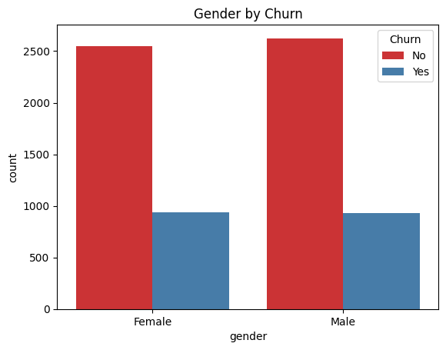
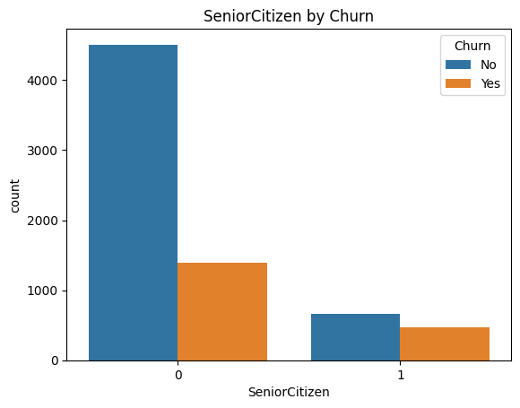
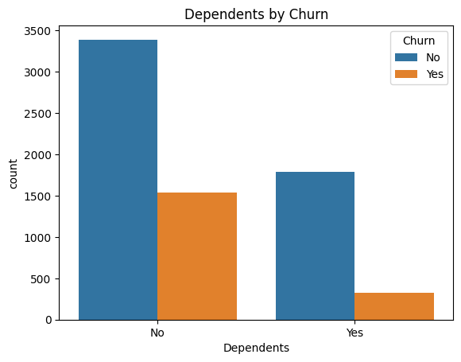
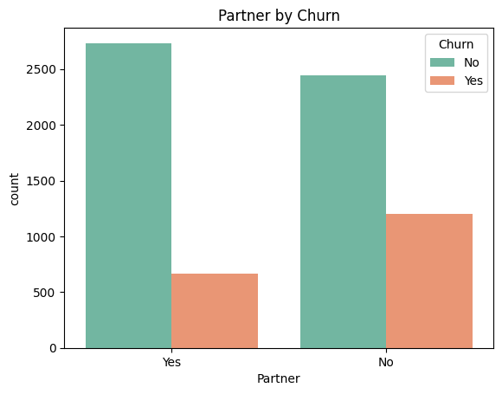
Exploratory Data Analysis
Most customers are non-senior citizens (0) and most of them did not churn, while senior citizens (1) have fewer customers but a relatively higher proportion of churn.
The churn rates are roughly equal between females and males, with slightly more males overall, but both genders
Customers without dependents have higher churn, while customers with dependents mostly do not churn.
Customers without a partner have higher churn, while customers with a partner mostly do not churn.

Slide 6
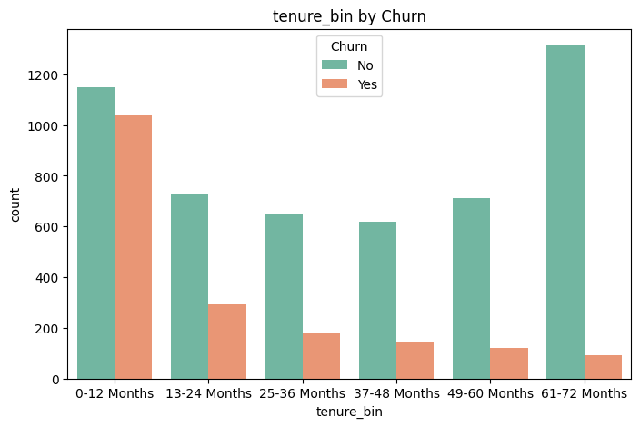
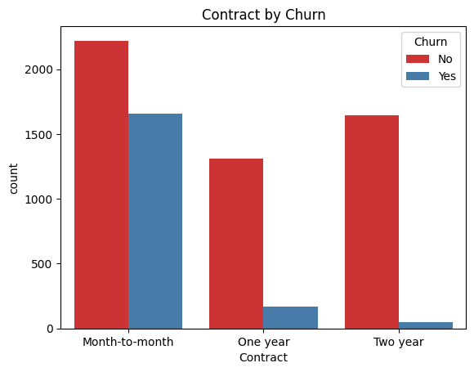
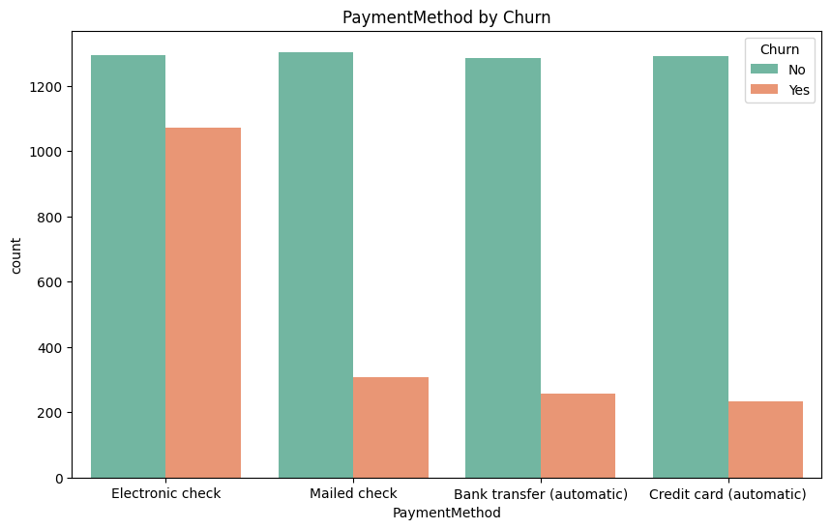
Exploratory Data Analysis
Customers with 0–12 months tenure show the highest churn, and the churn rate gradually decreases as tenure increases, indicating long-term customers are more likely to stay.
Customers with month-to-month contracts have the highest churn, while one-year and two-year contract customers show much lower churn
Customers using electronic check have the highest churn, while automatic payment methods like bank transfer and credit card show lower churn, indicating automatic payments help retain customers.

Slide 7
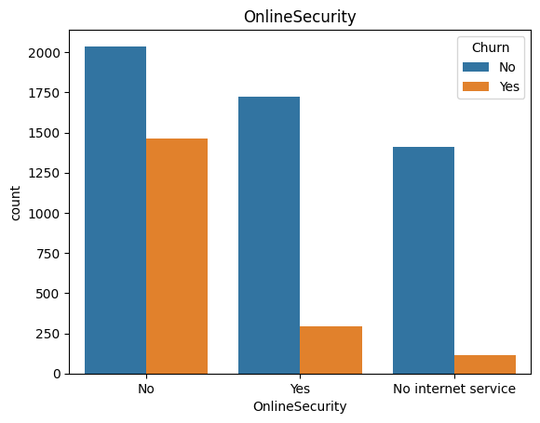
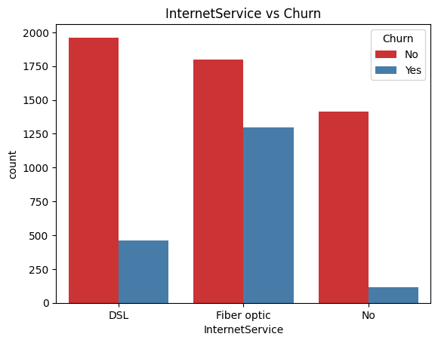
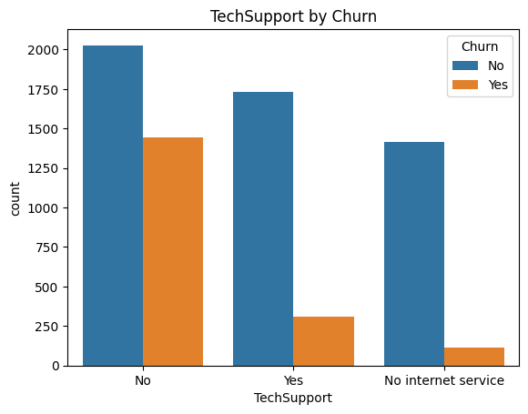
Exploratory Data Analysis
Customers without online security have much higher churn compared to customers who have online security.
Customers with Fiber optic internet have the highest churn, followed by DSL, while customers with no internet service have the lowest churn.
Customers without tech support have the highest churn, while customers with tech support churn much less.

Slide 8
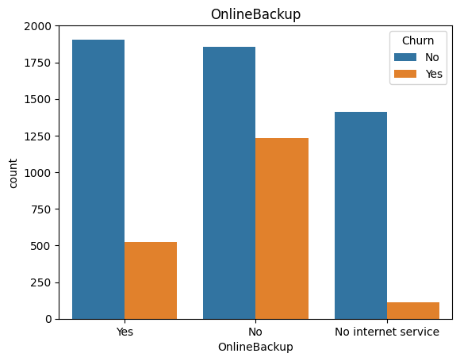
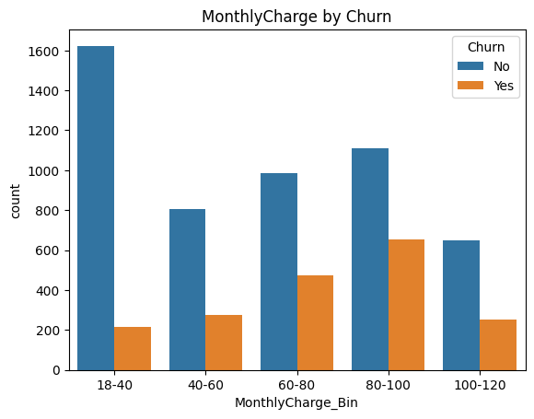
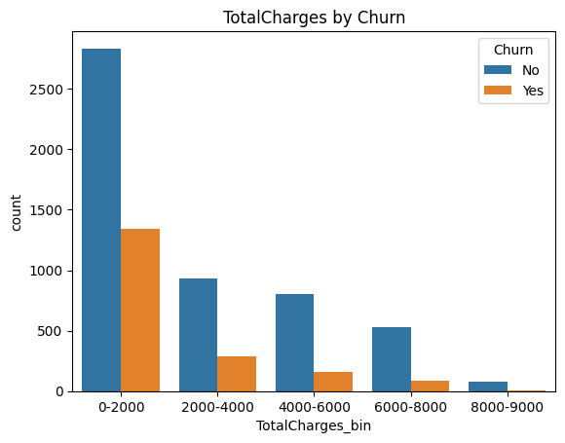
Exploratory Data Analysis
Customers without online backup churn much more than customers who have online backup.
Customers with higher monthly charges (especially 80–100) have higher churn compared to customers with lower monthly charges.
Customers with lower total charges (0–2000) have the highest churn, while churn decreases as total charges increase.

Slide 9
Data Preprocessing
EDA binning columns (tenure_bin, MonthlyCharge_Bin, TotalCharges_bin) were created only for analysis, so they were removed before model training.
Columns such as customerID , Phone Service were removed because they either act as identifiers or have very little impact on customer churn prediction.
Categorical features were converted into numerical format using One-Hot Encoding to make them suitable for machine learning models.
Label Encoding was used to convert the categorical columns Churn and Contract into numeric values so they can be used by machine learning models.
The target variable (y) was defined as ‘Churn’, and the remaining features were used as the predictor variables (X).
The dataset shows class imbalance: 5,174 customers did not churn, while 1,869 customers churned.
SMOTE was used to balance the dataset, followed by a stratified train-test split (70:30).

Slide 10
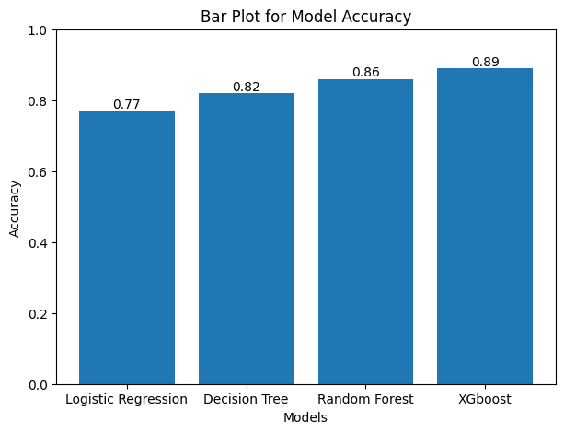
MODELS USED
Logistic Regression:-
Logistic Regression was used because it is simple, interpretable, and effective for binary classification.
Decision Tree:-
Used to capture non-linear relationships and provide easy-to-interpret decision rules
Random Forest:-
Use Random Forest because it handles mixed features well and captures complex non-linear patterns effectively. Used to improve prediction accuracy by combining multiple decision trees and reducing overfitting.
XGBOOST:-
A powerful gradient boosting algorithm that builds multiple decision trees sequentially to improve prediction accuracy and reduce errors.

Slide 11
Results Comparison
Model | Accuracy | Precision | Recall | F1 Score
Logistic Regression | 78 % | 0.75 | 0.83 | 0.79
Decision Tree | 81% | 0.79 | 0.80 | 0.80
Random Forest | 86% | 0.87 | 0.84 | 0.86
XGBOOST | 89 % | 0.75 | 0.78 | 0.78

Slide 12
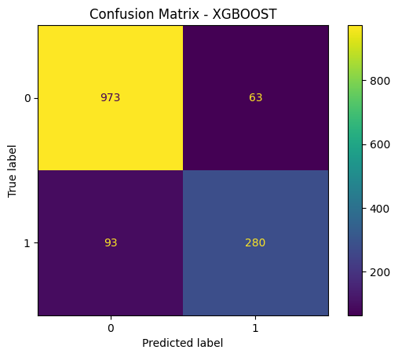
Model Evaluation
“Although XGBoost had higher accuracy, Random Forest was selected due to better balance between precision and recall and lower overfitting.”
Metrics Used:
Accuracy :- 86%
Precision :- 0.87
Recall :-0.84
F1 score :-0.86
Best Model : Random Forest
Accuracy : 86%

Slide 13
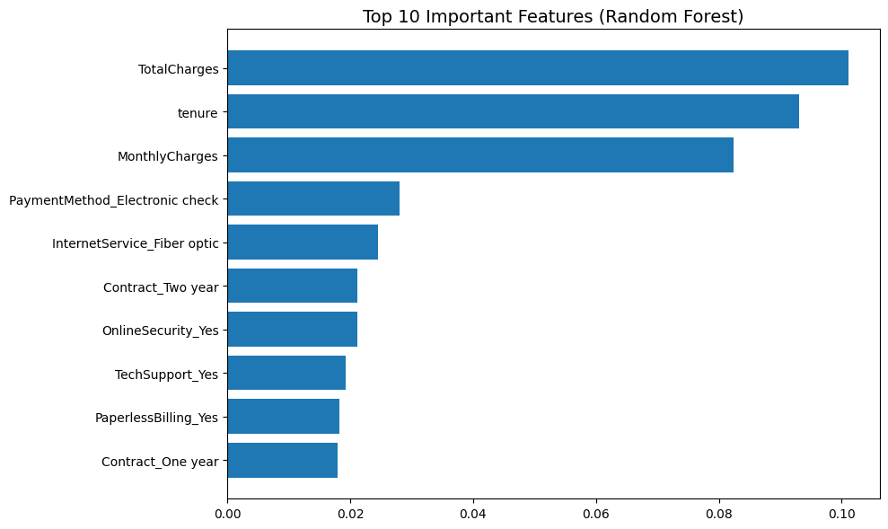
Feature Importance
Top Features Influencing Churn:
• Month-to-Month Contract → Highest churn risk
• Low Tenure (0–12 months) → High probability of churn
• High Monthly Charges → Increased churn likelihood
• No Tech Support → Customers more likely to leave

Slide 14
Conclusion
“Although XGBoost had higher accuracy, Random Forest was selected due to better balance between precision and recall and lower overfitting.”
The Customer Churn Prediction model was developed using multiple machine learning algorithms, and Random Forest achieved the best performance with high accuracy. The model effectively identifies customers at risk of churn.
Key factors influencing churn include contract type, tenure, monthly charges, and service usage.
Business Impact
Identifies high-risk customers early to take preventive action.
Reduces customer churn, leading to better retention.
Protects and increases revenue by minimizing customer loss
Enables targeted offers and personalized strategies

Slide 15
